Slide 1
Planning Strategically for the Future
Joan Rataic-Lang, Toronto Lawyers Association Connie Crosby, Crosby Group Consulting
CALL/ACBD 2017, Ottawa, ON
Tuesday, May 9, 2017
Sponsored by:

Slide 2
Planning Strategically for the Future
Introduction: New Law
Strategic Planning & Strategic Management
Exercise: Threats and Opportunities
High Performance Organizations
Wrap-up: Measuring for Success

Slide 3
Welcome to NewLaw

Slide 4
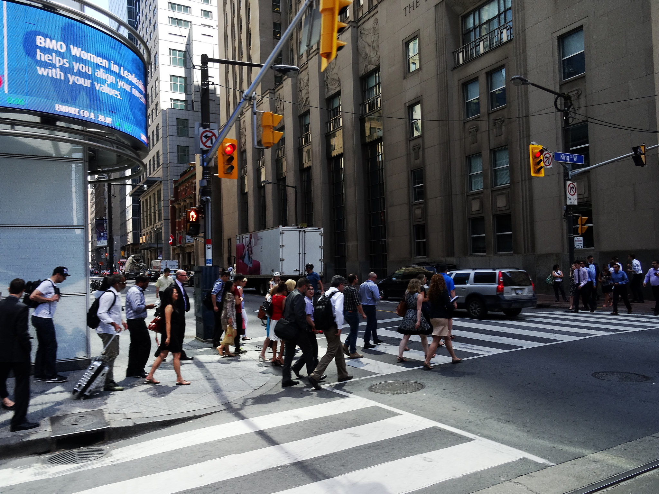
Economic changes
Contributing Factor
Source: https://flic.kr/p/9cwVJU

Slide 5
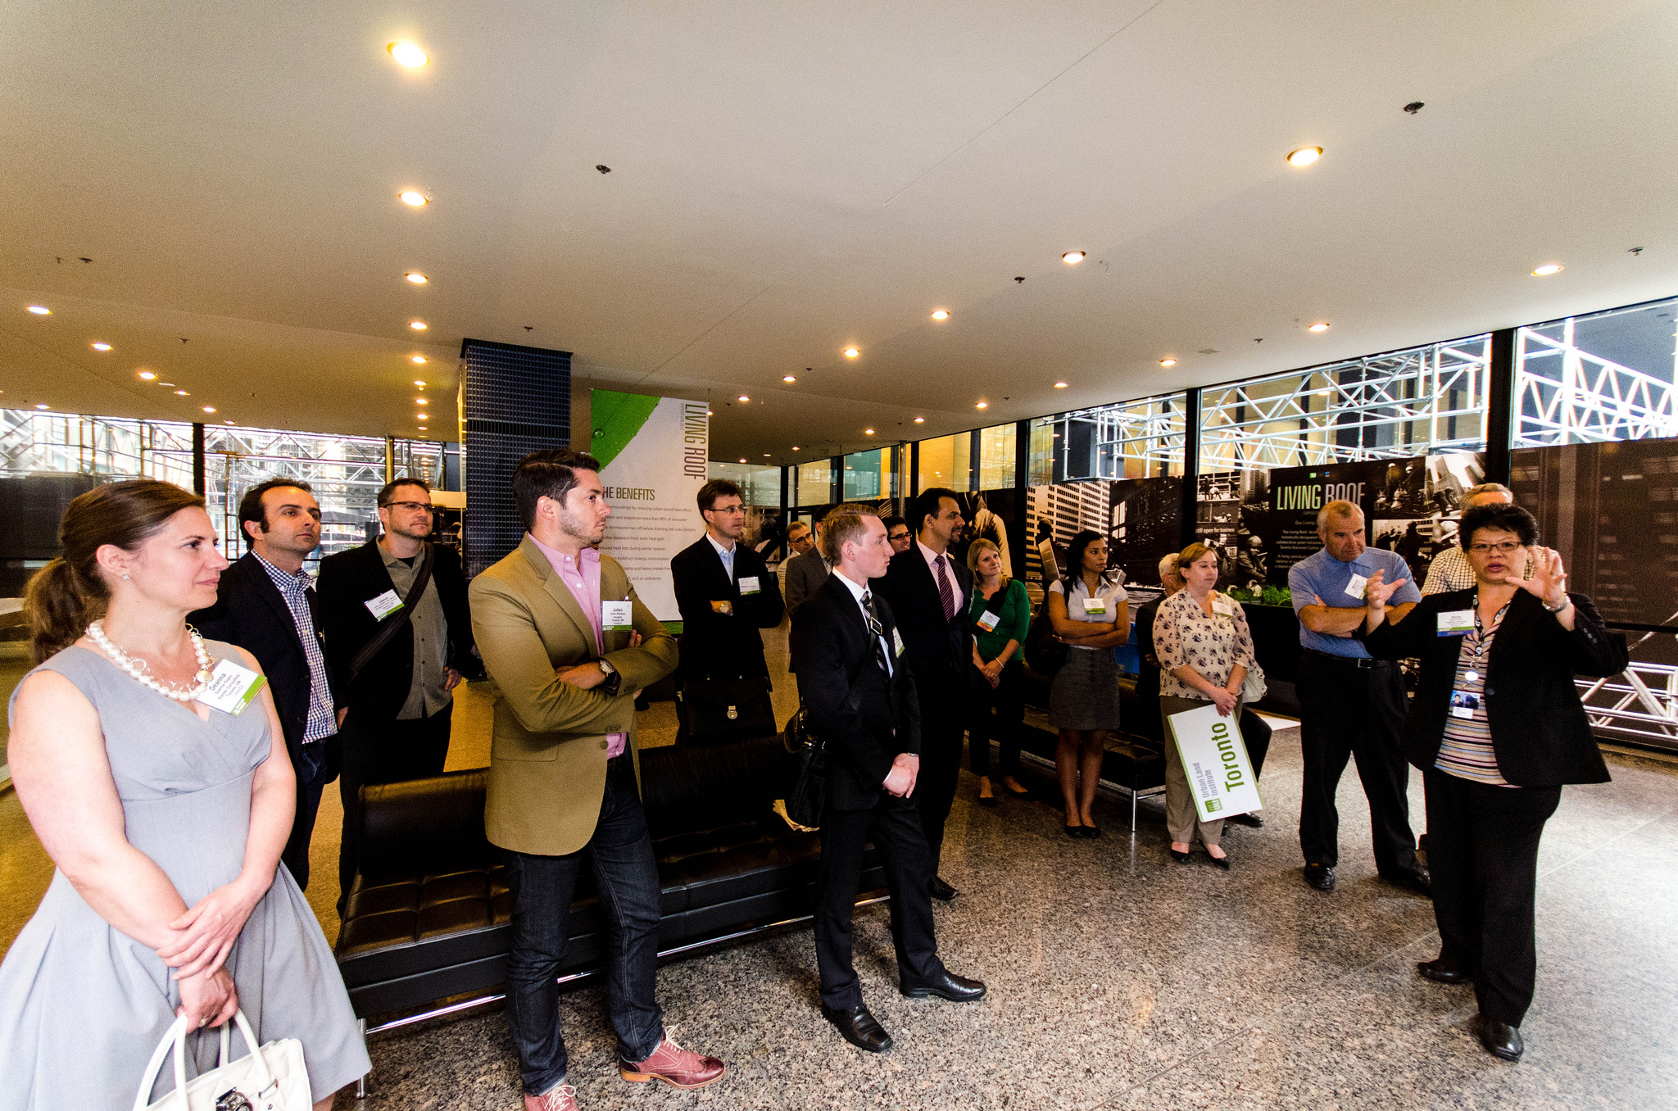
Corporate client demand
Contributing Factor
Source: https://flic.kr/p/coYAiC

Slide 6
Technological advances
Contributing Factor

Slide 7
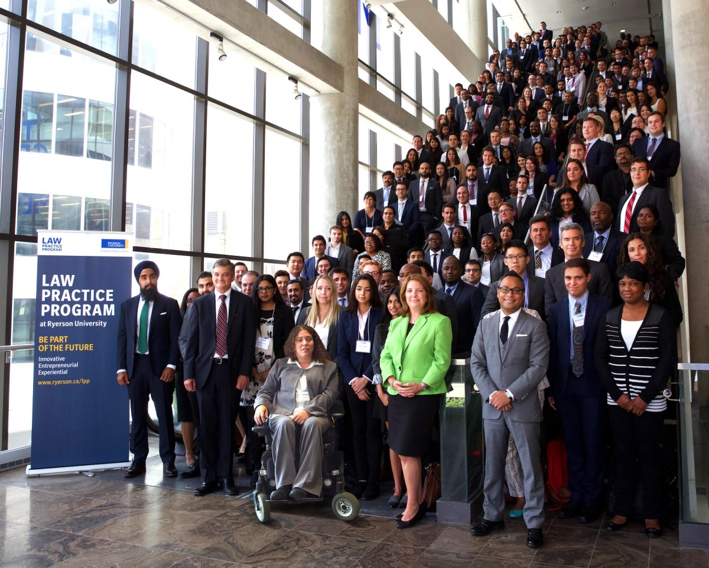
Law students > articling positions
Contributing Factor
Source: http://www.lpp.ryerson.ca/?event-gallery=lpp-launch-week-2016-2017

Slide 8
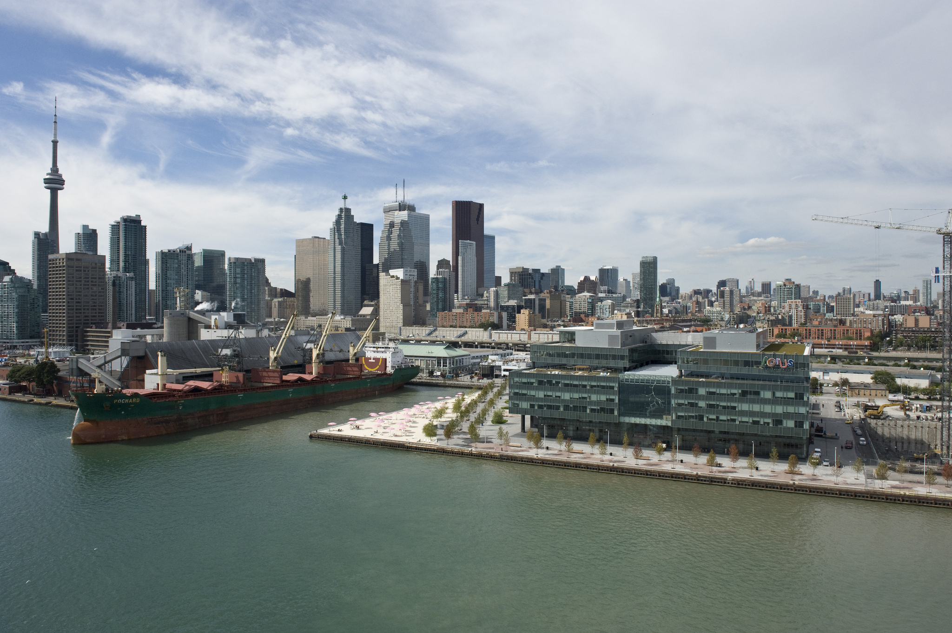
More client-focussed
Source: https://flic.kr/p/hmkNZv
Notes:
Organizations are striving to be more client-focussed

Slide 9
More efficient
Source: https://flic.kr/p/9cwVJU
Notes:
Becoming more efficient as a way to reduce overhead and administrative costs, save time, and make costs more predictable for clients. This is not easy to do when the billable hour has been the dominant model.

Slide 10
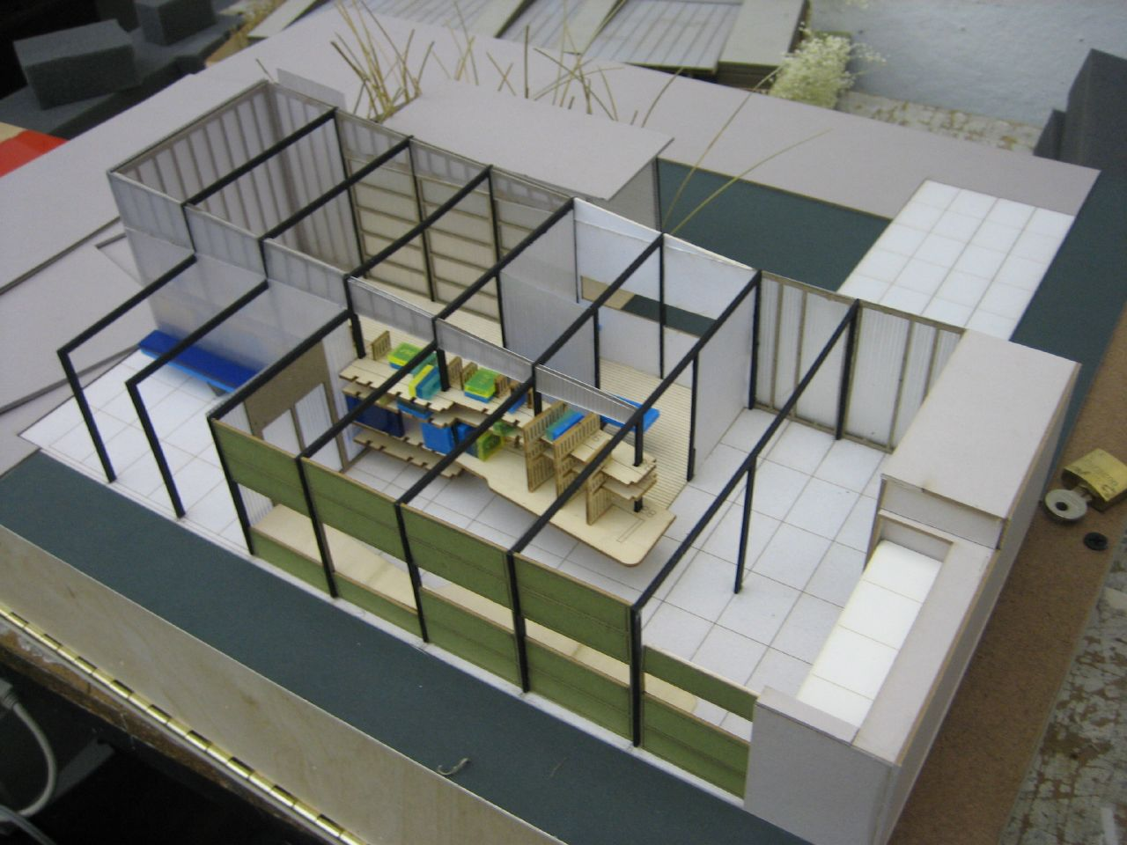
Breaking old models
Source: https://flic.kr/p/aqJGo
Notes:
In other words, our tried-and-true models are no longer working. Although some individuals in our industry are in denial, things are needing to change.

Slide 11
Desire to make costs predictable
Result
Source: https://flic.kr/p/dP1j9K

Slide 12
Striving to be innovative
Result
Source: https://flic.kr/p/eEFTfy

Slide 13
Working with other professionals
Source: https://commons.wikimedia.org/wiki/File:Tv_classic_catwoman_%26_batgirl_cosplay_(14234105402).jpg
Result

Slide 14
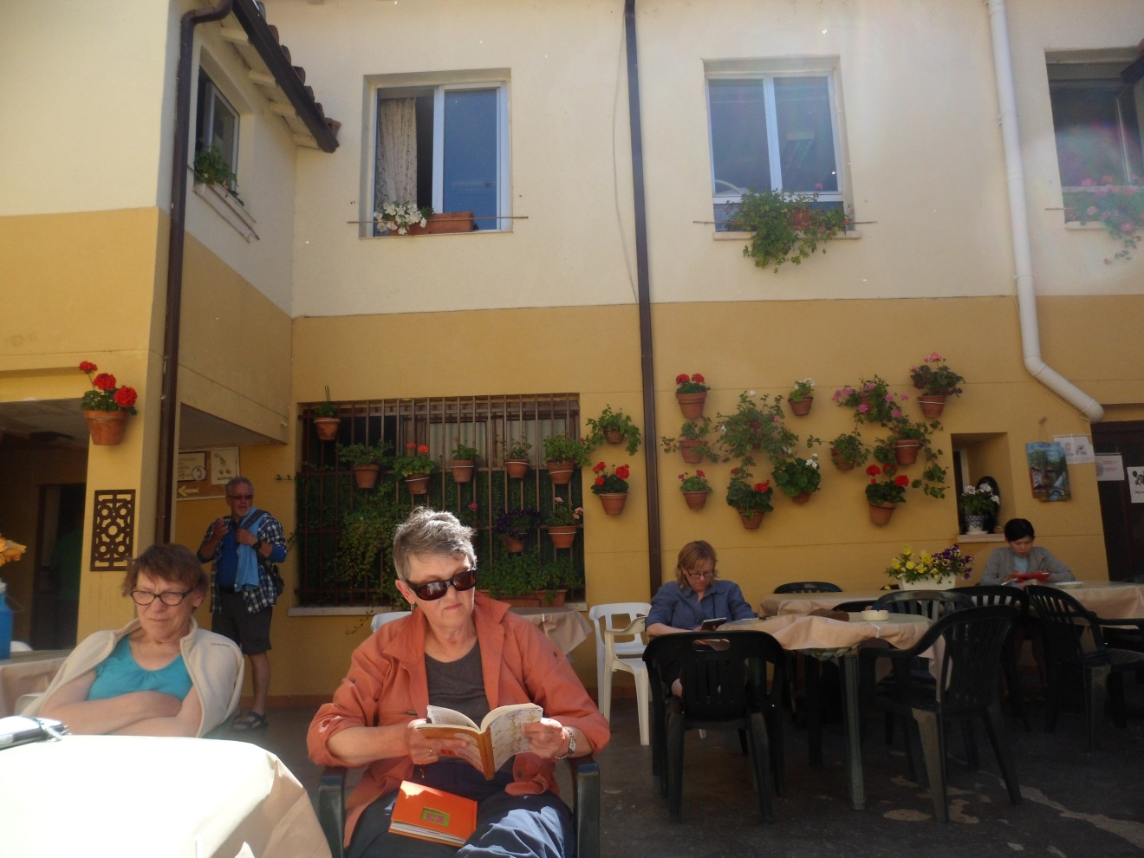
Planning: are you being strategic?
Notes:
Strategy means a plan of action designed to achieve a goal. Being strategic is the art of planning. It does involve some time for contemplation.
Strategic Planning includes several elements:
They include Strategic Plans – they are documents that communicate an
organizations goals,
the actions needed to achieve those goals
and the other elements developed during the planning.
Often they are at written at high level and outline where you want to go or– where you should be going to support your organization
Does your organization have a Strategic Plan. You will need to make sure you are aligned with it. Simple example, the firm has decided cost cutting is a pillar. I harken to 2008 when that was a big thing at many of our firms. If the library comes out with a plan that talks about increasing staff you will have a problem.
Strategic Management Model – helps determine how you get there

Slide 15
What is your plan?
Notes:
All the pictures used are from a walk Connie and I did – we walked from France through northern Spain along the Camino de Santiago de Compostela. Just as a reference, the way is marked with yellow arrows or shell images. I am surprised how often I can repurpose the pictures taken on the trip.
Strategic Management is the systematic implementation of a strategy. In our case, we wanted to get to Santiago. There are many Camino’s across Spain, all going to Santiago, but taking different routes.
As you plan, you will find that the discussions, decisions, conclusions, are all unique to your organization.
Long range planning is getting more difficult.

Slide 16
Notes:
We need to anticipate the immediate.

Slide 17
Notes:
But there is no harm at looing into the future to see what awaits us.

Slide 18
What’s your strategic maturity level
Notes:
We could talk about our employers – the organizations you work in. They may not be very mature or they may be at level 5. Either way, what we are going to discuss is your library’s level of maturity.
And note, I will just use the term library for simplicity’s sake.
I think you can all determine what we should aspire to. If we look at the dimensions that should be considered in the evaluation, we will see that many of them are discussed in the elements of a High Performing Organization, which we will talk about later.

Slide 19
Change ahead
Notes:
Convention management assumes predictability – look at the past as a predictor of the future.
That’s not the case anymore. How many of you are tired of all the discussion of disruptors?
Strategic management assumes that change will occur. It outlines a process that is
Proactive
Responsive
Dynamic
While none of us have a crystal ball that tells us what will happen in the very distant future, we can try to anticipate and plan.

Slide 20
How to respond to change?
Notes:
Something as simple as having a rain cover for our backpacks easily accessible, because the rain in Spain, falls – everywhere, not just on the plains.
What will your rain cover be?

Slide 21
Facets of Strategic Management
Notes:
This very simple model is my preferred choice because it includes analysis. Most do not clearly set up analysis as an important step.
What I am going to introduce you to is not easy. Planning is not easy because it requires time, human and fiscal resources and buy-in from staff.
We are going to cover 10 steps. The important thing to note is that while in some cases the order may changed, the steps themselves are important and each have a place

Slide 22
Step 1: What values does the library stand for?
Notes:
Michael Brennan blogs on Building a Strong Nonprofit. In his blog about Core Values he wrote:
Values “should serve as important guideposts in shaping culture, making hiring decisions, setting strategic direction and influencing the way an organization interacts with its stakeholders. Core values should be the few essential tenets that are non-negotiable in the organization – timeless and unchanging.”
To give you an example I have included the Values Statement from the Toronto Public Library.
Equity: Accessibility, respect and fairness
Diversity: Valuing individual needs, experiences and differences
Intellectual Freedom: Guaranteeing and facilitating the free exchange of information and ideas in a democratic society, protecting intellectual freedom and respecting individuals' rights to privacy and choice
Innovation: Encouraging creativity, experimentation and the generation of ideas
Inclusion: Welcoming participation in decision making and service development by residents and communities
Integrity: Open, transparent and honest in all our dealings
Accountability: Taking responsibility for our actions and the services we provide
Service Orientation: Providing excellent, responsive services
From http://www.torontopubliclibrary.ca/about-the-library/mission-vision-values/

Slide 23
No one answer is right for all libraries

Slide 24
Just figure out what is important in your organization
Notes:
Michael Brennan blogs on Building a Strong Nonprofit. In his blog about Core Values he wrote:
Values “should serve as important guideposts in shaping culture, making hiring decisions, setting strategic direction and influencing the way an organization interacts with its stakeholders. Core values should be the few essential tenets that are non-negotiable in the organization – timeless and unchanging.”
To give you an example I have included the Values Statement from the Toronto Public Library.
Equity: Accessibility, respect and fairness
Diversity: Valuing individual needs, experiences and differences
Intellectual Freedom: Guaranteeing and facilitating the free exchange of information and ideas in a democratic society, protecting intellectual freedom and respecting individuals' rights to privacy and choice
Innovation: Encouraging creativity, experimentation and the generation of ideas
Inclusion: Welcoming participation in decision making and service development by residents and communities
Integrity: Open, transparent and honest in all our dealings
Accountability: Taking responsibility for our actions and the services we provide
Service Orientation: Providing excellent, responsive services
From http://www.torontopubliclibrary.ca/about-the-library/mission-vision-values/
Let’s talk about a few of these:
2nd one – in hiring we are often tempted to hire someone like us, studies have shown. If we hire diversely then we are bringing different sets of touchpoints, experiences, ideas to the table – those make us richer as an organization
Innovation – they encourage creativity, experimentation – maybe that’s why the TPL is rated so highly?

Slide 25
Step 2: What Have Been the Library’s Past Successes and Failures?
Notes:
They say that hindsight is 20/20. It’s true that we cannot undue mistakes made, but neither should we ignore them. We can learn from failures. Equally we learn from what has worked.
The details are necessary when looking at successes and failures. We can then see if there are trends that can be pulled out. They will help you figure out your strengths and weaknesses which we will be discussed in a future step.

Slide 26
Notes:
They say that hindsight is 20/20. It’s true that we cannot undue mistakes made, but neither should we ignore them. We can learn from failures. Equally we learn from what has worked.
We do an Articling Student Headstart program at the TLA – we make adjustments, who the speakers are, when in the month we will do it, what we cover,
We offer Quicklaw training. When it is generic, not well attended, We are trying to make it more valuable by covering topics.
In our case we walked a mountain range – he experience was both exhilarating and scary – and we learned lots about ourselves from this.

Slide 27
Notes:
The details are necessary when looking at successes and failures. We can then see if there are trends that can be pulled out. They will help you figure out your strengths and weaknesses which we will be discussed in a future step.

Slide 28
Step 3: What are the Library’s Main Functions?
What areas does the library focus on?
Notes:
What areas does the library focus on?
For example – Reference still plays a large role in law firms. That is a main function.
Quite simply identifying them on paper is important. At this point you may also think of things that are not main functions. That’s fine keep a list of opportunities or ideas.
Through this whole multi-step process you are documenting, and eventually pulling it all together

Slide 29
Notes:
What areas does the library focus on? You may be like this little bar, providing a variety of fast food and drink.

Slide 30
Notes:
Or like this little store, which had something for everyone.

Slide 31
Notes:
You may only provide a very limited service
For those of you who don’t recognize these they are grape vines

Slide 32
Notes:
Or you may be very different from every other library around .
What matters is that you make a list of everything that you do.
identifying your functions on paper is important. It will be a learning experience.
You may realize at this point or through more indepth work that not everything is equally as important. I once worked in a law firm and we had a really big team, and we came to the conclusion that perhaps too much time was being spent on where the commas in cataloguing records appeared.
As is common with these types of exercise you may come up with a list of opportunities or ideas.
Through this whole multi-step process you are documenting for later use.

Slide 33
Step 4: Who are the Library’s Stakeholders?

Slide 34
Step 4: Who are the Library’s Stakeholders and What do we Know About them?
Who are the individuals or groups that are affected by the library’s activities?
articling students
associates
partners
others?
In your organization - who are they?
Notes:
Who are the individuals or groups that are affected by the Library’s activities?
My reference point has always ben law firms
articling students –
associates
Partners – directly or indirectly
note that the handout only has the usual suspects – students, partners, associates .
Are there others?
Administration – Executive Committee/managing partner
Human Resources
marketing
business development
assistants
clients
What do we know about them? this could be a discussion on its own.
To me the generational issues are important. But there also may be things specific to the culture of your firm.

Slide 35
Step 5: does the Environment Tell Us?
What
SWOT Analysis
Notes:
A critical step is the SWOT Analysis.
Can anyone tell me what SWOT stands for?
SWOT stands for strengths, weaknesses, opportunities and threats.

Slide 36
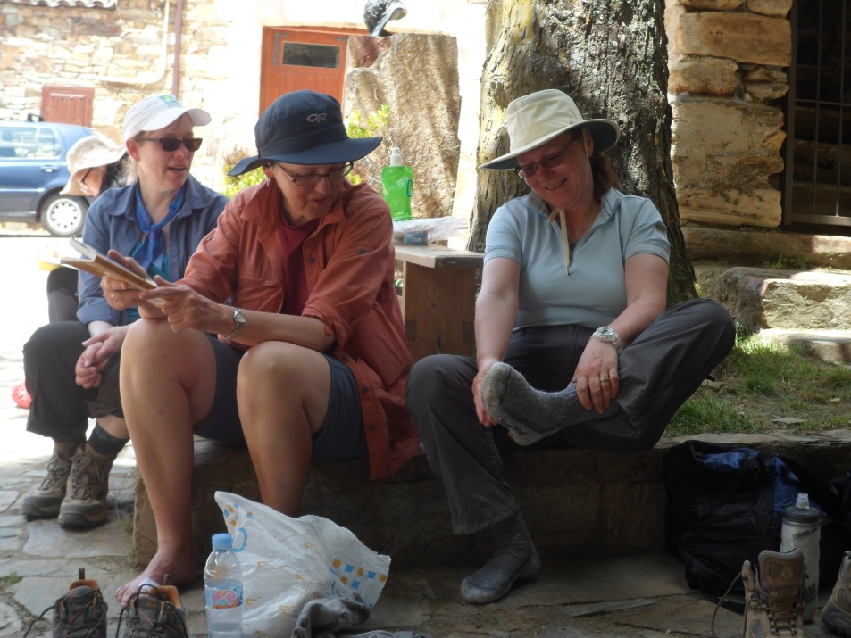
Internal: Strengths & Weaknesses
Notes:
Strengths and weaknesses are internal to the organization
This requires trust and honesty, no one likes to look at one self critically.
To move forward you need to recognize what needs improvement
And what you can build on

Slide 37
External: Opportunities & Threats
Notes:
external factors are opportunities and threats.

Slide 38
Notes:
Seeing the threats

Slide 40
Notes:
Can be challenging. We know they are there.

Slide 41
Notes:
There are any number of ways that SWOT analysis can be performed with surveys, focus groups, interviews, collecting anecdotal informational and current and past performance data.
Eventually you will be determining your “willed future”.
By completing the SWOT analysis you will be able to identify the gap between where you are and where you want to be and the direction to take will be clear.

Slide 42
Step 6: What is the Library’s Vision?
Notes:
As a foundation, every Library needs to have three basic elements that guide what the Library does. Values have been discussed in Step 1. Here we address the Vision statement:
Vision statements are aspirational descriptions of what an organization would like to achieve or accomplish. These statements are designed to be uplifting and inspiring. They're also timeless: even if the organization changes its strategy, the vision will often stay the same.
But the vision is based on current and anticipated stakeholder needs and trends and issues in the environment. How would you like your library to look in the future.
Read more: http://www.businessdictionary.com/definition/vision-statement.html
For example
Ikea (retail) – "To create a better everyday life for the many people."
What is your vision, what does your library aspire to?

Slide 43
Step 7: What is the Library’s Mission?
Santiago de Compostela Cathedral
Notes:
Mission statements also define the organization's purpose and primary objectives. These statements are set in the present tense, and they explain why you exist, both to members of the organization and to people outside it. Mission statements tend to be short, clear and powerful.
A mission statement usually answers the following questions:
Who are we?
Why do we exist and what need are we meeting?
How do we meet the need?
Who do we serve?
What makes us different or unique?
Example of Mission
Nike (athletics) – "To bring inspiration and innovation to every athlete in the world.“
We are Toronto Lawyers. Our mission is to promote and provide knowledge, advocacy and community.
Our vision is a highly engaged community that creates essential resources for Toronto lawyers.
These are confusing and sometimes it feels like they overlap. The point is to start developing what you aspire to.

Slide 44
Step 8: How Will Success be Measured?
Each function should have specific goals assigned to it, remembering that the goals need to be tangible outcomes.
Notes:
Now armed with some useful thinking. We have an environmental scan, that is our SWOT from Step 5.
We have identified our vision and mission statement.
Now it is time to determine what success factors will look like.
In step 3 we determined what are the library’s main functions.
Each function should have specific goals assigned to it, remembering that the goals need to be tangible outcomes.
It will be really tempting to put the cart before the horse at this point. You will hear lots of “we should do this” or “let’s try that” or “or users would surely like that.” Don’t get caught up in those, time for that will come.
At this point the list of goals may get quite lengthy. It is important to document them all. You will quickly realize that you cannot achieve all the goals. You can document everything, and then pick from the list.
The changing landscape that you operate in may require a reassessment.

Slide 45
A leisurely morning break.
Notes:
We defined success by enjoying ourselves – it was not a race

Slide 46
After dinner fun at the hostel with our new friends.
Notes:
We made lots of friends and had fun.

Slide 47
Step 9: What are the Strategic Issues?
“a strategic issue is any concern or problem serious enough to be considered an issue and requiring resolution.”
David Mikkelsen. "Chapter 5: Strategic Management." Canadian Association Management.
Notes:
Basically, “a strategic issue is any concern or problem serious enough to be considered an issue and requiring resolution.” Mikkelsen, David, CAE. "Chapter 5: Strategic Management." Canadian Association Management.
However, if the issue is ignored and there will be negative results, then it is an issue.

Slide 48
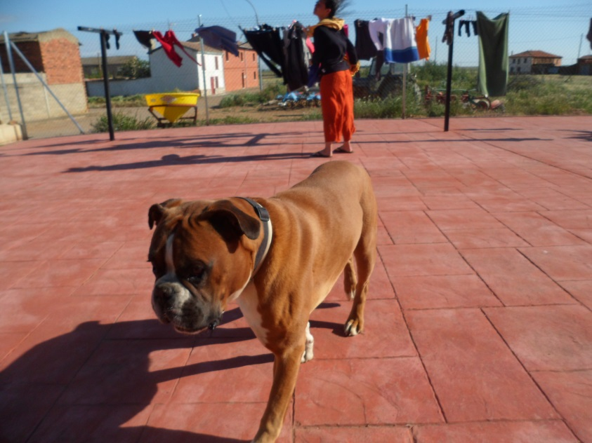
Watch out for the wild dogs of Spain
Notes:
To help understand what an issue is, consider this: if nothing is done, will anything happen? If not, then it is not an issue.
We didn’t bother the dogs, they didn’t bother us. Not an issue.

Slide 49
Forgotten walking poles or backpack . . . disaster
Notes:
However, if the issue is ignored and there will be negative results, then it is an issue.

Slide 50
Step 10:
What Tactics will Make the Goals a Reality?
Notes:
In step 8 we identified Goals - The tactis identified here will make those Goals actually happen.
In determining your tactics you will be
Setting priorities
Determining where to focus the library’s energy and resources
This should result in an operational plan. A tactical plan. A business plan - the stuff that you will do, who will do it, when and how. The owner of this plan could win the lottery and leave for the Caribbean tomorrow and someone else could step in and make it happen.
Ultimately - Your plan will bridge the gap between the current state and the future – where you want to be.
A plan cannot stand on its own, but requires a number of other elements to be in place:

Slide 51
Appropriate Organizational Structure in Place
Notes:
Resource support

Slide 52
A Culture Conducive to Change
Notes:
A culture conducive to change

Slide 53
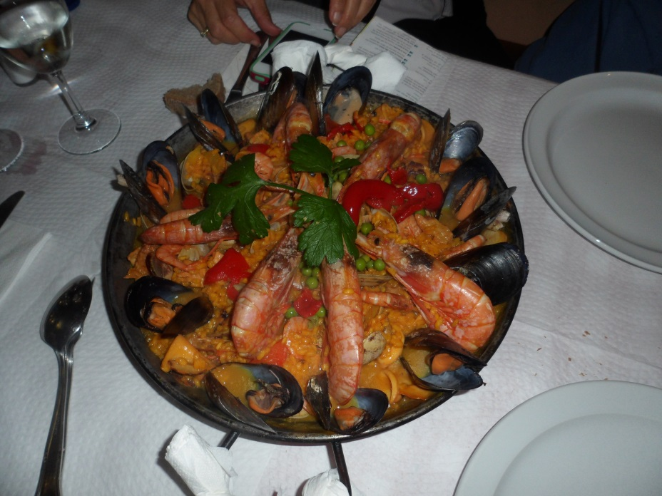
Resource Support
Notes:
Make sure that you have the appropriate organizational structure in place
you need to have a committed staff to make this happen

Slide 54
Committed Staff

Slide 55
It never ends
Planning
Implementation
Evaluation
Notes:
In simple terms the Strategic Management Model (SMM) is a three stage process.
The SMM starts with Planning, which flows into Implementation and is concluded by Evaluation.
When fully in place it is a virtuous circle that does not have a beginning nor an end, but rather is an ongoing and continuous process.
At the beginning I mentioned the Strategic Plan After completing this work you can create a Strategic Plan to share with your organization. The beauty of doing it now means that you will be able to produce a realistic document. Yes it is intended to be aspirational, but yours will be based in a thorough analysis. Of course the culture of your firm will also help you decide on this step.
You may think if the firm does not have one, why should I? You are a leader, show initiative and forethought – become part of the inner circle at your firm
Make sure that your goals align with the firm’s.
What have we not talked about – Implementation and monitoring, making it happen and evaluating if it is working.

Slide 56
Activity: Identifying Opportunities & Threats for your role in NewLaw

Slide 57
SWOT Analysis

Slide 58
High Performance Organizations
Notes:
Like with the Strategic Management Model you will find many definitions and frameworks for HPO’s. In it’s simplest terms this graphic identifies the components.

Slide 59
HPO more specifically
Notes:
This graphic gets a little deeper than the previous one. We will delve a little more in our next exercise, but first – why aspire to be an HPO?
According to the HPO Center
Revenue growth, shareholder return, all those fiscal measures. But there are other outcomes as well
Higher level of customer satisfaction
Increased customer loyalty
More employee job satisfaction
Better cooperation (open for positive feedback / feedforward)
Better service and product quality and innovation
Less complaints
As far as I can tell, these are all good things.
The legal sized handout is thanks to the Boston Consulting Group.
The framework that I work within has been modified to fit the non-profit sector and covers things like the Member Value proposition, governance and Revenue Diversification. Looking at the for-profit environment, there are other factors that are important. So back to the handout.
The Boston Consulting Group is a global management consulting firm that has had the opportunity to work with a variety of types of organizations. Through their own work a team at BCG has determined that there are fourteen characteristics, grouped into five broad categories, that they call capabilities, that are common to most high-performance organizations.
What I propose we do is have a group discussion about the categories and their characteristics and you take some notes. Those notes can be examples of how this translates to your library, ideas on how to make this work in your library, or anything else that makes sense to you.

Slide 60
High Performing Organizations
Categories | Characteristics
Leadership: Leadership is aligned and effective deep within the organization | 1. High performance teams of leaders drive strategy. 2. Pipeline is stocked with future leaders. 3. Middle managers embrace and translate strategy.
Design: The structure is lean and reflects the organization’s strategic focus | 1. Structure and resource allocation reflect strategic trade-offs. 2. Few layers separate the CEO and frontline and spans of control are wide. 3. Accountabilities, decision rights and collaboration are constructed with thoughtful consideration

Slide 61
High Performing Organizations
Categories | Characteristics
People: The organization effectively translates business strategy into powerful people strategy, attracting and retaining the most capable individuals. | 1. The employer brand is a core asset. 2. Critical roles and key talents are clearly identified and treated with care. 3. HR is a strategic partner and enabler of the business
Change Management: The organization can drive and sustain large-scale change and anticipate and adapt | 1. Change is a disciplined cascade. 2. The organization is evolutionary.
Culture and Engagement: The culture is shaped to achieve strategic goals. Employees pursue corporate objectives | 1. Culture accelerates strategic objectives. 2. Engagement is measured and cultivated to generate discretionary effort from employees.

Slide 62
Measuring for Success
Notes:
Tie your metrics back to your strategy and tactics. What are your goals? Measure to show whether you are meeting those goals. Also, always try to tie back to your organization’s overall goals e.g. client satisfaction and profit (bottom line).

Slide 63
Bottom line
Measuring
Source: https://flic.kr/p/qLtZq8
Notes:
How much did you save your organization? How much did you earn for your organization? Track this over time. Small increments sometimes add up year-over-year.

Slide 64
Customer/client satisfaction
Measuring
Source: https://flic.kr/p/6MEmjM
Notes:
Who is the client? Those who use your library? Or your organization’s clients? As process improvement methods increase, customer/client satisfaction becomes increasingly important. Do you have a way to measure on a regular basis? What is important to your client? Have you saved them time or money? Given them a piece of mind? Made costs more predictable? Made them look good? Knowing this will allow you to better measure improvement over time. Simple measures such as how much time they were spending before and after, or satisfaction before and after help you collect and monitor metrics over time to see improvement or decline.

Slide 65
Time spent & saved
Measuring
Source: https://flic.kr/p/nN3cfZ
Notes:
Most law firms are still very much tied to the billable hour. But even without tracking billable hours, do you know how much time it takes to do a specific task? How much it costs you to offer a service, and the “break-even” point for it? Time is money, after all, even without the billable hour. You need to be able to estimate how much it is going to cost to be able to give an appropriate price. Can you show how much time you have saved the client? This is tied back to value given to the client. Again, this helps you estimate how much to charge a client for the service, whether from the library or from your organization.

Slide 66
Whether you think you can, or you can’t – you’re right. Henry Ford
Notes:
This slide summarizes our attitude about getting things done. The right mind-set will take you far.
Last slide

