Slide 1
The Digital Litigator: Throwing Away the Binders and the Briefcases
Conference of the Canadian Association of Law Libraries
May 9, 2017

Slide 2
Modernity
We adopt new technologies at home faster
than we do at work.
How can we up our game in the workplace?

Slide 3
Duty of Competence
Reasonable basic technological proficiency is part of a lawyer’s duty of competence.
Must understand, for instance, what social media are and how they are used in society.
Must ask questions such as:
How can technology help/impede my work?
Do we have relevant information on social media?
Do they have relevant information on social media?
It cannot be dismissed as “that thing the kids do”

Slide 4
What’s a “Digital Litigator”?
The digital litigator:
takes full advantage of the benefits of working digitally; and
presents its case digitally.
Court documents
Pleadings
Documentary evidence
Notes taken during a hearing
Online research on the fly

Slide 5
Our current “digital” practice
Counsel scan pleadings or print them directly to PDF, store them on their laptop, and use Acrobat Reader to view the documents.
PowerPoint may be used to make presentations in Court.
Even so, litigators continue to bring paper copies (just in case).
There’s no common or recommended practice concerning using electronic documents and tools at trial.
Documentary evidence can be scanned. If produced out of a document review platform, it may be in TIFF format with Bates stamps.
In some cases, we bring the entire set of documentary evidence with us in a standalone database not requiring Internet access.

Slide 6
How do you get there?
Make it possible to become digital
Create a sense of urgency towards to digital
Show what others (within and outside the organization) are doing
Talk about success stories and failures (and what to do about those)

Slide 7
Enable digital work: the Digital Workspace
A Department-wide project, the Digital Workspace aims to help us organize, manage, share and communicate information across the Department.
JustMe: personal site complete with newsfeed, blog and document library that will eventually replace the personal network drive.
Collaboration sites: to store and share documents and other content with people and groups across the department. Document libraries have full version control, optimized document search features and backup. Will replace the shared drives.

Slide 9
Keep it electronic
To maximize our ability to demonstrate the integrity and its authenticity of documents
To make review and analysis faster and cheaper
Collect electronically stored information (ESI) in a forensically-sound fashion
i.e. without altering the documents integrity including its metadata.
Special tools are required to this end.

Slide 10
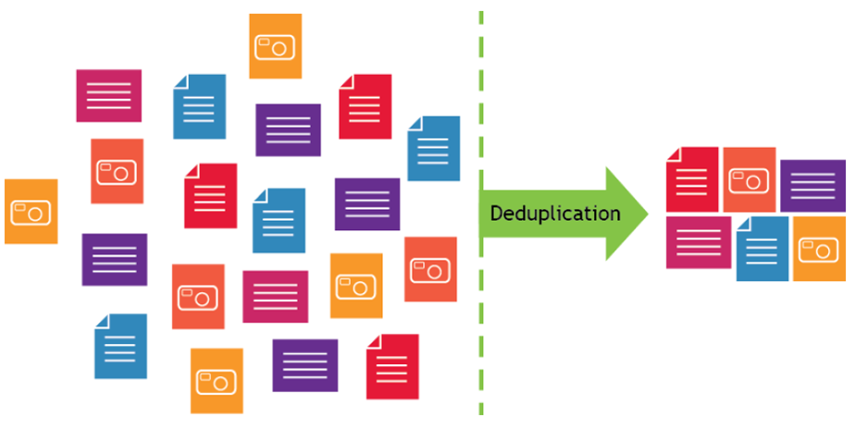
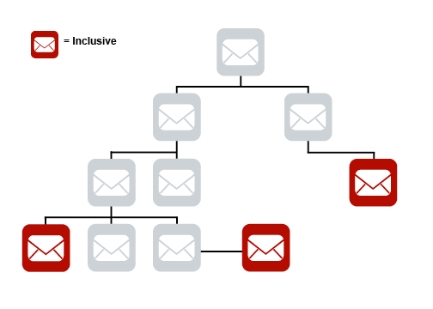
Filter it electronically
Objective culling: Reducing the size of the collection based on considerations not requiring the exercise of discretion by legal professionals (i.e. deNISTing, deduplication, conversation threading).
Subjective culling: Reducing the size of the collection based on subjective decisions of legal professionals (e.g. date range, keyword searches, file types, and email extensions)

Slide 11
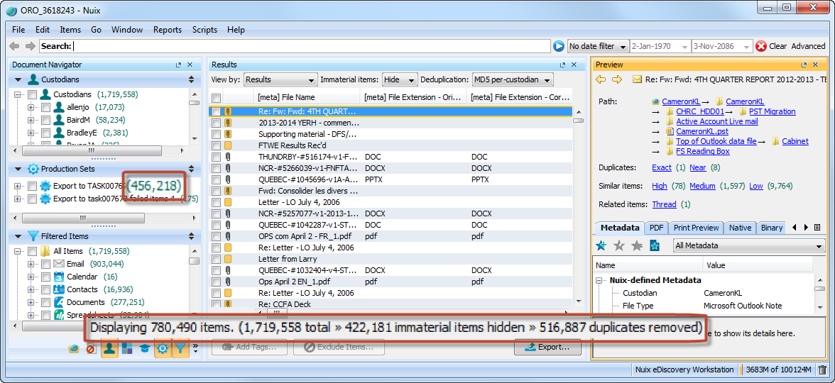

Slide 12
Review it electronically
Use a document review application to store, review and make decisions concerning documentary evidence
You can use it to:
Simply store and track documentary evidence
Search the content or the metadata of those documents
Record decisions or comments concerning documents
Link transcripts to documents
Assemble documents in issues
Perform redactions and bates numbered productions

Slide 13
Review it electronically
… or you can make use of the application’s advanced analytical features
Mines and clusters
Visual representation of important concepts in documents and how closely documents relate to one another
“Find similar”
Retrieval of conceptually similar documents
Cubes
Document data presented in spreadsheet format
Predictive Coding
Machine learning: the application learns from your action and takes over.

Slide 14
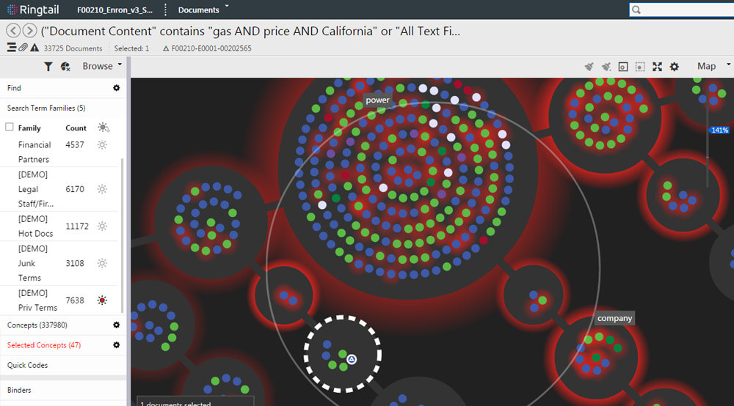

Slide 16
Analyze it electronically
Have the tools help litigators establishing their theory of the case and figure out which documents are important for what allegations concerning which witness.
Create lists of issues, facts, witnesses, and documents
Organize legal research
Creating fact chronologies
Create linkages between facts, documents, people/witnesses/organizations, transcripts and issues
Record decisions and annotations.

Slide 17
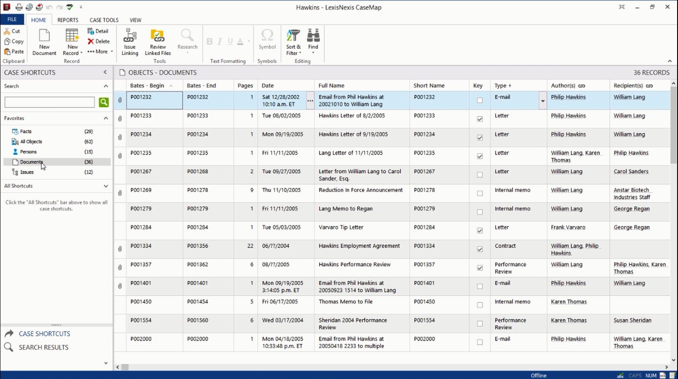

Slide 18
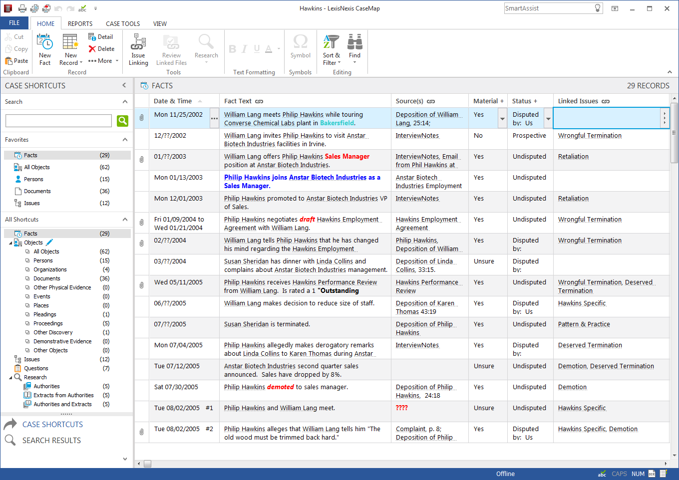

Slide 19
Present it electronically
Three projects at Justice:
Trial presentation
Mobile Courtroom
eTrial

Slide 20
Trial Presentation
To test the capabilities, usefulness and user-friendliness of trial preparation and presentation tools enabling litigation teams to persuasively present information electronically.
Software designed to make it easy to plan, create and present compelling electronic presentation of evidence at trial.
Should contribute to a significant reduction in the number of paper documents that need to be brought to court.
Counsel’s reticence at trying such technology for the first time in a real case.

Slide 21
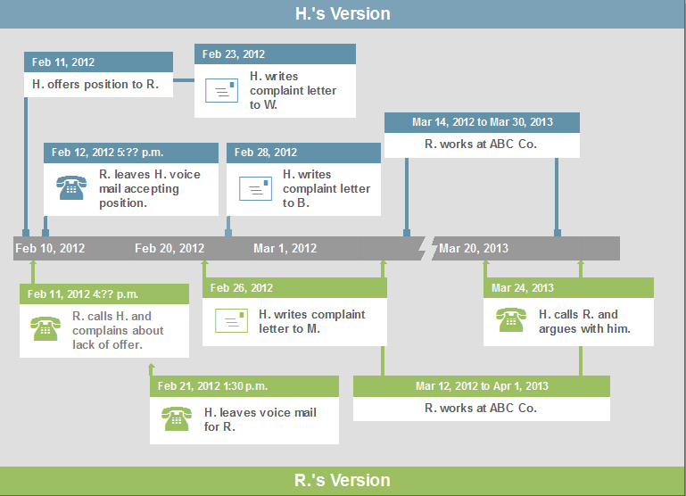
Trial Presentation
Helps litigators simplify case facts into timeline visuals to demonstrate vital case facts.
Simple to use, TimeMap proved extremely popular with litigation teams. Demand outnumbered available pilot licences.

Slide 22
Trial Presentation
TrialDirector and Sanction are presentation software with additional functionality not offered by Acrobat or PowerPoint.
Exhibit management, text magnifier, zoom, highlighters, pointers, side-by-side comparison, video playback synched with transcripts, and on-the-fly annotations.

Slide 23
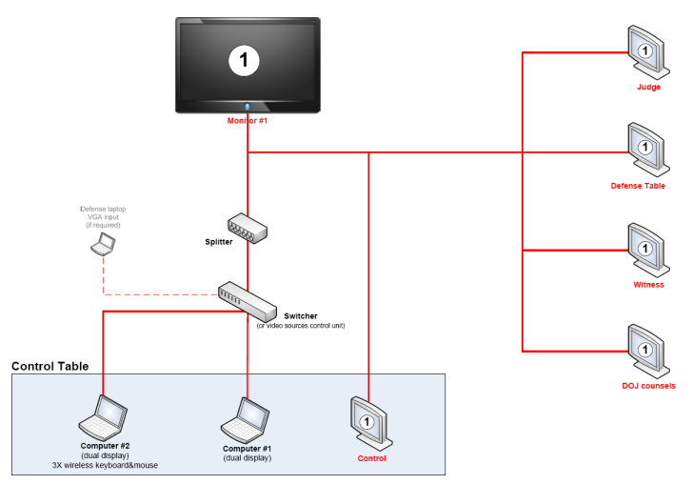
Mobile Courtroom
The courtroom lacks the necessary equipment to display evidence electronically?
The Mobile Courtroom suite allows counsel to display evidence on a network of monitors around the courtroom, rather than referring to hard-copy documents.
Audio-visual equipment which can be deployed to a courtroom in order to temporarily outfit it with monitors for all parties and the court.
Planning well in advance of trial dates and a court-approved electronic trial agreement is critical.

Slide 26
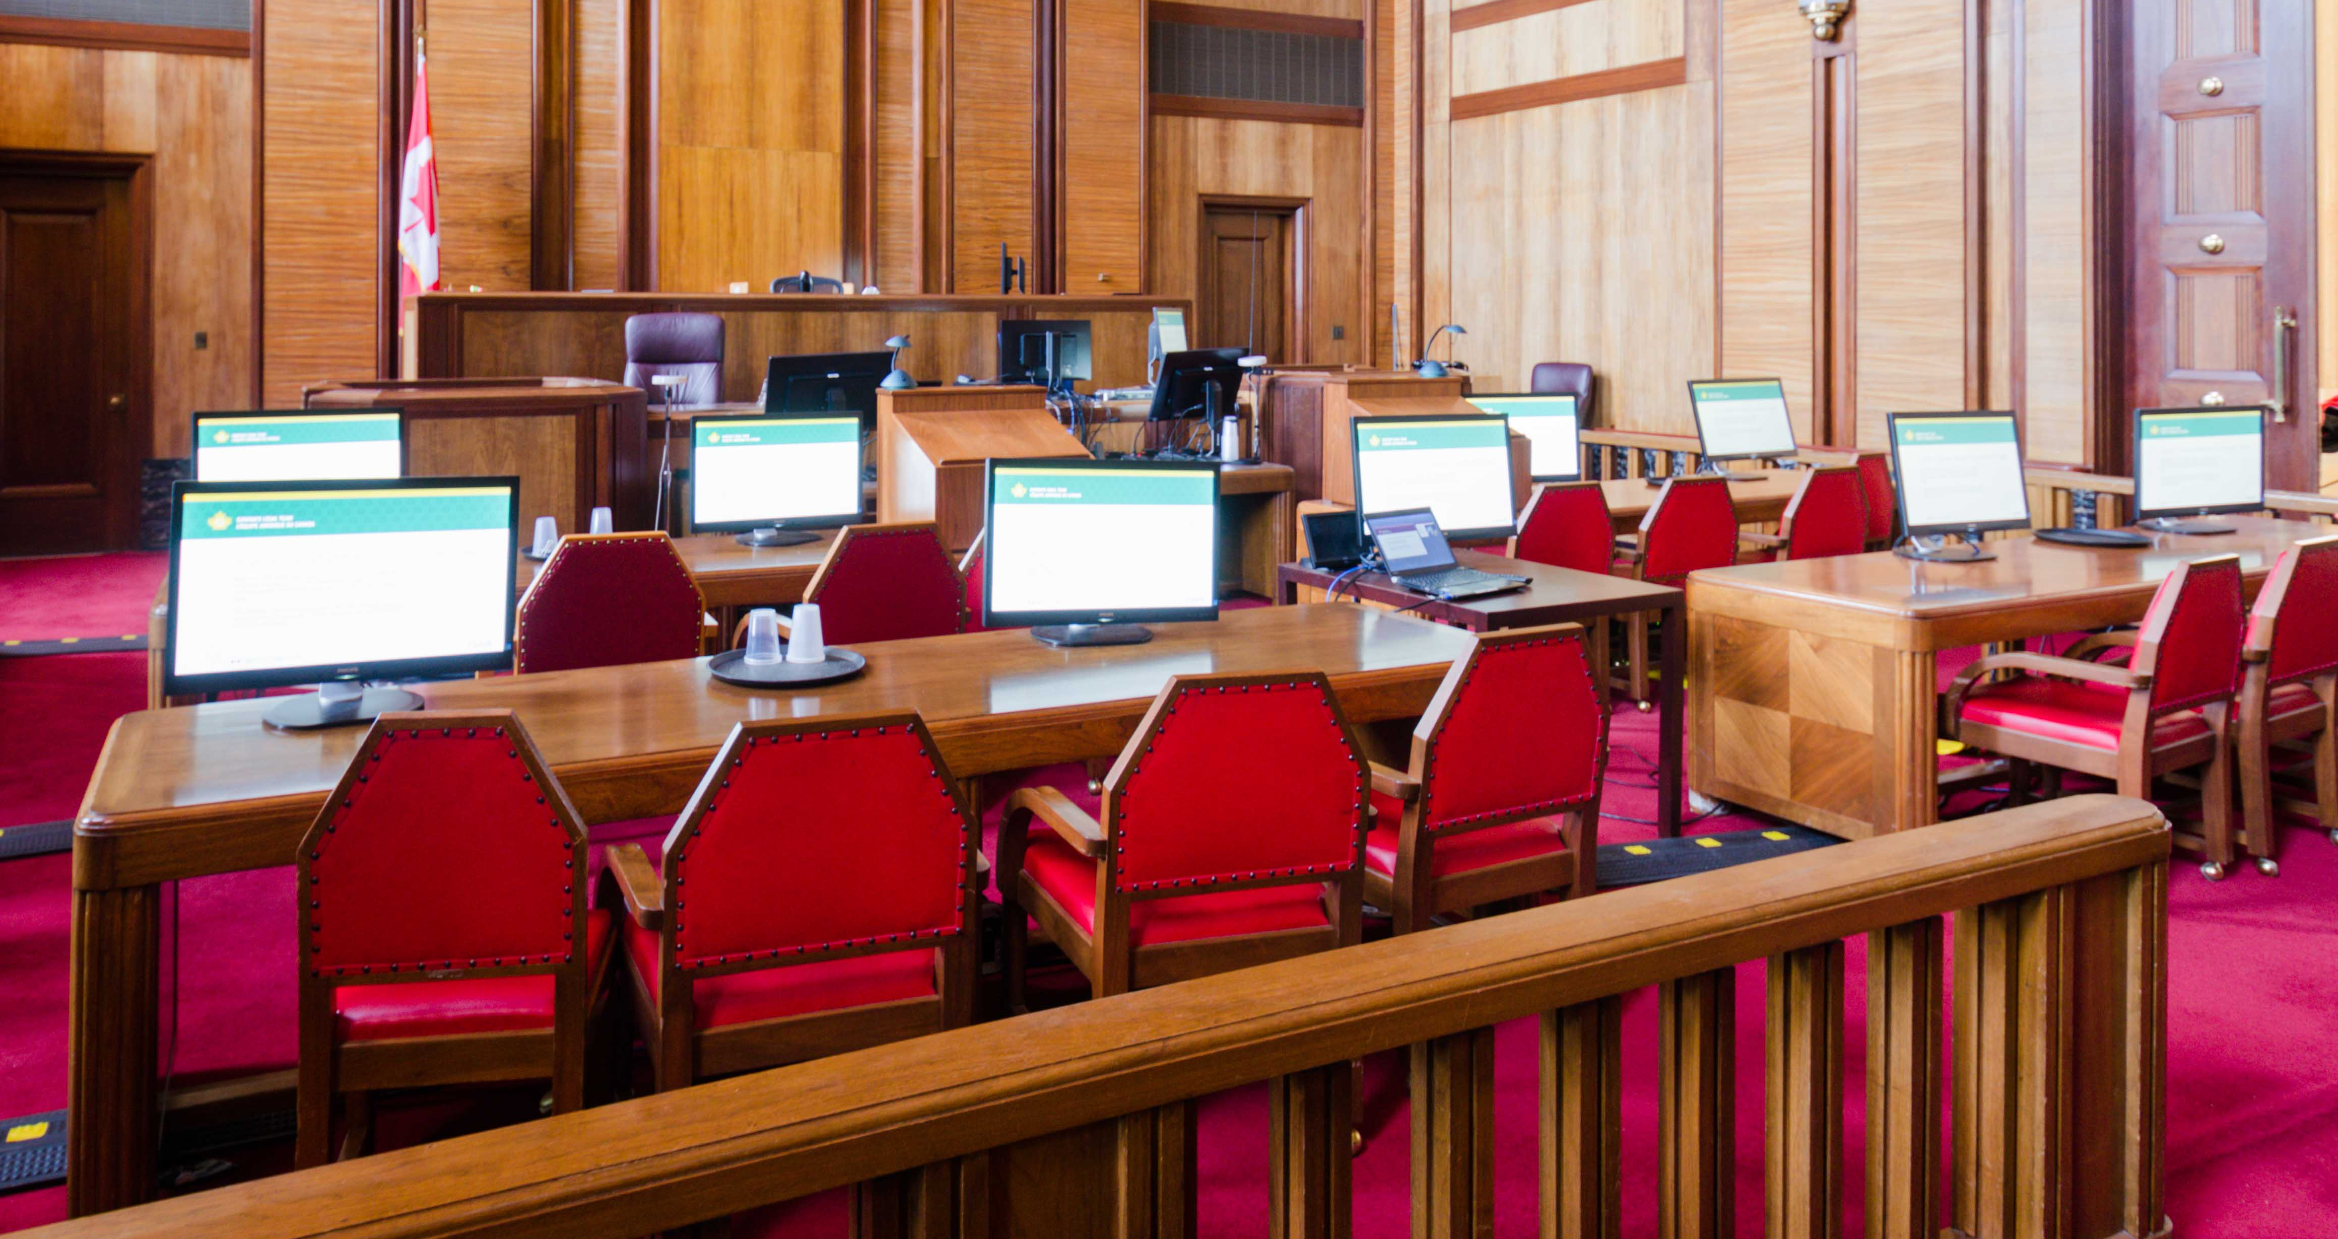

Slide 27
Mobile Courtroom – Best Practices
eTrial agreement arrived at early in the process
Discuss the cost of support
Involve the court from the beginning
Install material well ahead of the trial
Test it.
Give an opportunity to parties/court to try it first.
Other resources:
Ontario Bar Association’s ‘E-Trial Checklist’ and ‘What is an electronic trial?’
The Advocates’ Society’s ‘Paperless Trials Manual’.

Slide 28
Next Step: eTrial
A concept more than a project, it seeks to provide tools to enable litigators to attend trial armed with only electronic documents and device.
One device and a common format to store pleadings, authorities, documentary evidence, and other case-related documents. One device on which to enter notes taken at trial.
A first step: Annotated Court Reporter Project. How can we let go of our bound court reporters? What options are available? What new practice will we need to adopt to replace notes in marginalia?

Slide 29
Next Step: eTrial
What format should the information be in?
The information should be searchable and indexed. A choice to be made between native documents, individual PDFs, Single PDF, or PDF Portfolio.
What tools should we use?
Counsel’s own work laptop, special dedicated laptops, or tablets (iPad or Surface Pro).
Other considerations: Ease of use, ability to store information locally (Internet-free), redundancy, Internet tethering.

Slide 30
Final considerations
Conviviality: Strive for simplicity and intuitiveness
Secure end user buy-in: consult & engage
Test it out
Help them organize their digital practice
One application per task, not 12
Interoperability
Business continuity/disaster recovery
Security

Slide 31
Jean-Sébastien Rochon
Department of Justice Canada
National Litigation Sector
National eDiscovery and Litigation Support Services
(613) 960-4933
jrochon@justice.gc.ca
Views expressed in this presentation are my own.
References to specific products does not constitute endorsement of the product
by the Department of Justice or myself.

