Slide 1
The 2017 Canadian Copyright Review: Making the Case (Again) for Balanced Copyright
Professor Michael Geist
Canada Research Chair in Internet and E-commerce Law
University of Ottawa, Faculty of Law

Slide 3
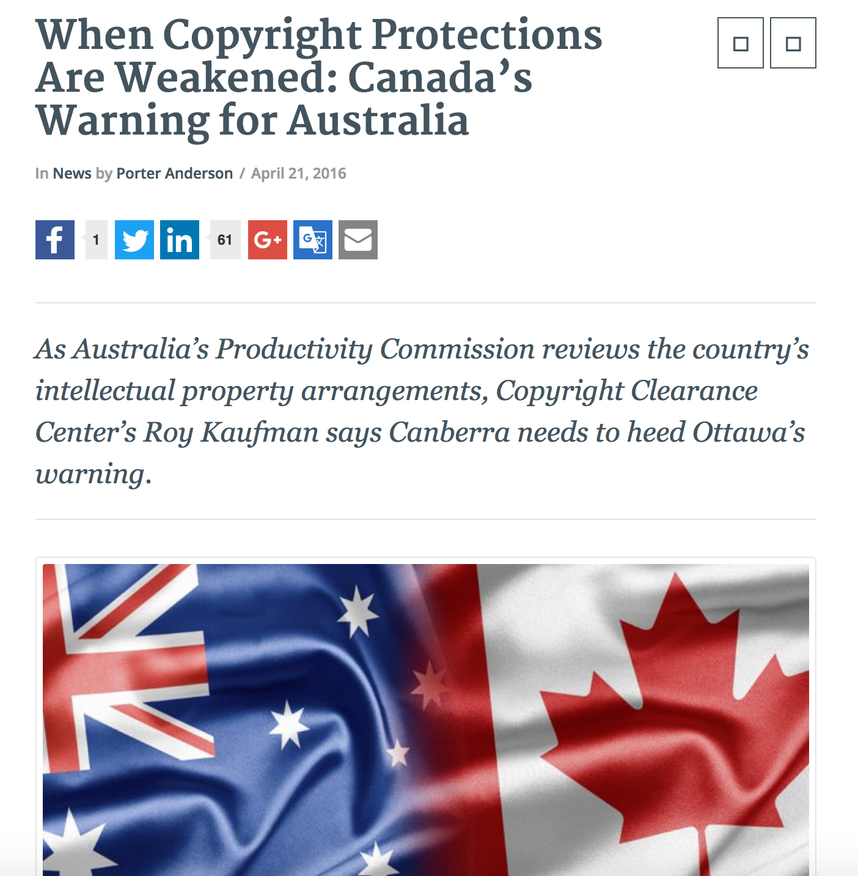

Slide 4
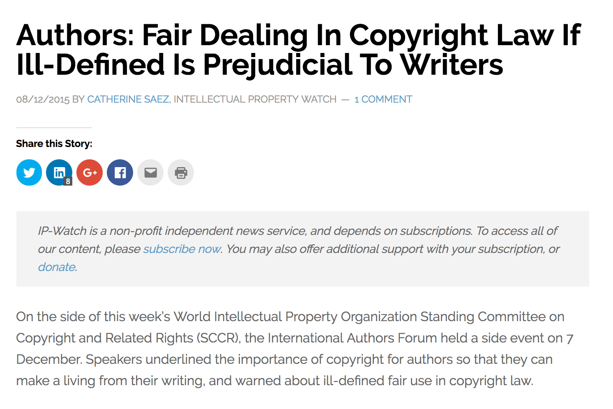

Slide 5
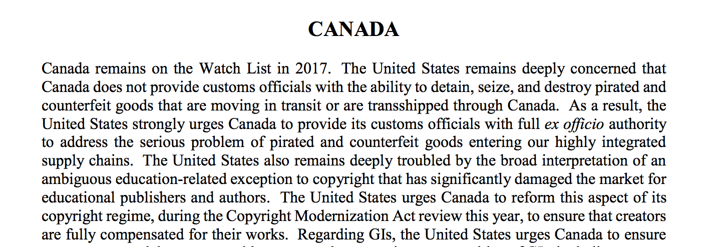

Slide 6
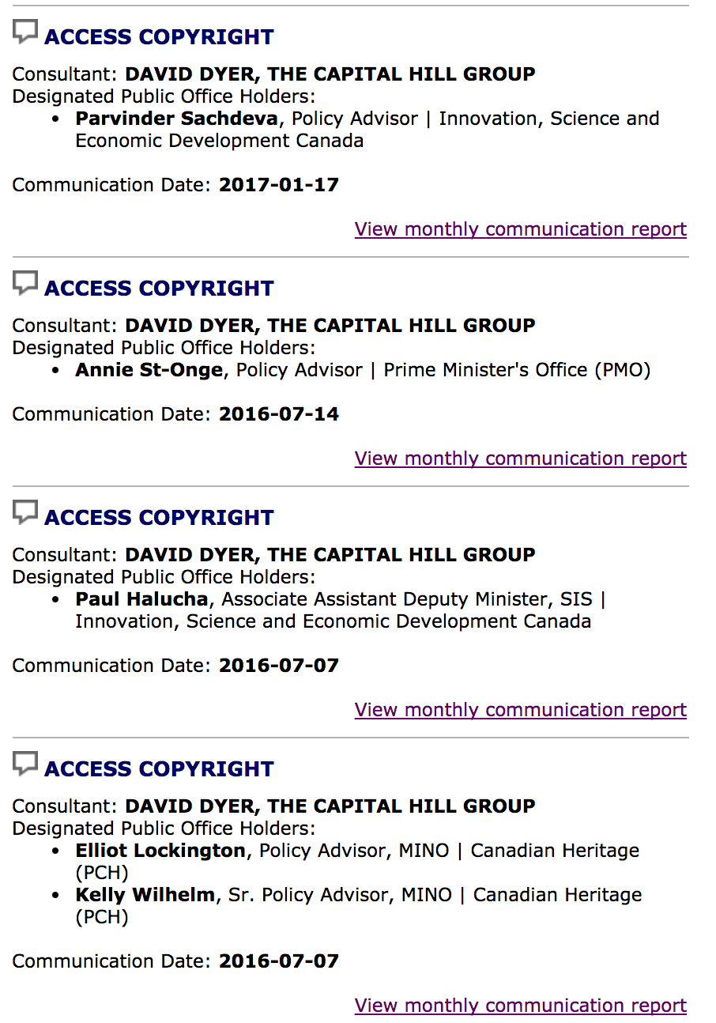

Slide 7
2017 Review

Slide 8
Notes:
Mandated review – will happen and Liberals have emphasized it

Slide 9
What did Canada do? What has happened since? How to preserve balanced copyright in 2017?

Slide 10
What Did Canada Do?

Slide 12
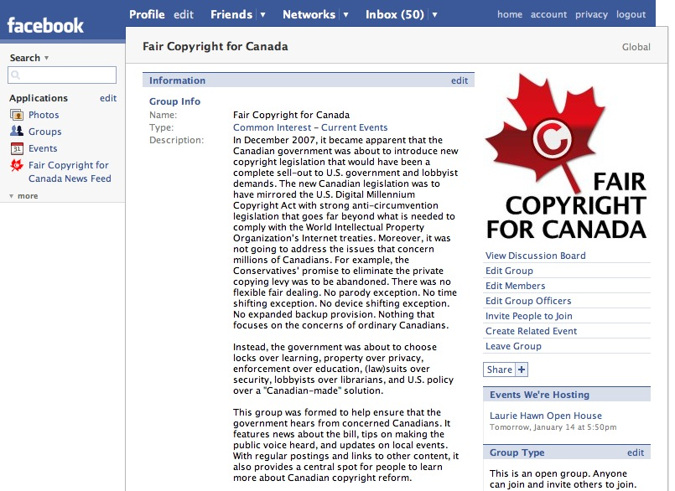

Slide 13
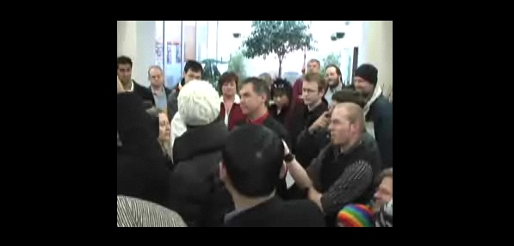
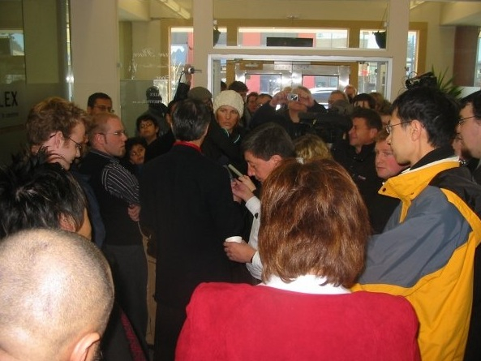

Slide 16
Process
2000 – 2012
Multiple bills and government studies
Successive governments (both Liberal and Conservative)
National consultation in 2009
Final substantive bill in 2010
Extensive hearings in 2011
Bill passes in 2012
Emergence of many new voices throughout the process
Started as WIPO implementation and gradually expanded to copyright modernization

Slide 17
User Exceptions
Expansion of fair dealing
Format shifting (reproduction for private purposes)
Time shifting
Backup Copies
Non-commercial User Generated Content
Publicly Available Materials on the Internet
Distance education
Cinematographic works
Reproduction in class
Digital Inter-Library Loans

Slide 18
Rights Holder Demands
Anti-circumvention rules (DMCA-style)
Enabler provision
Photographer’s rights
ISP liability (notice-and-notice)
Statutory damages

Slide 19
SCC
Theberge (2002)
overprotection v. under-protection
CCH (2004)
user’s rights, balance
fair dealing
Six factors (purpose, character, amount, alternatives, nature, effect)
Copyright pentalogy (2012)
user’s rights
balance
fair dealing – research, private study
Technological neutrality

Slide 20
What Has Happened Since?

Slide 21
<1>
Copyright is Never Ending

Slide 22
Implementation
Notice-and-Notice Problems
Fight Against Fair Dealing
Anti-Circumvention

Slide 23
New Legislation
Sound recording term extension
Marrakesh treaty implementation
Term extension (Private Member’s Bill)

Slide 24
Courts
Tech neutrality (CBC v. SODRAC)
Fair Dealing
Manitoba v. Access Copyright
Blacklock’s Reporter v. Canada
TPMs (Nintendo of America v. King)
File sharing
Voltage – Teksavvy
Voltage – Rogers
ILTs (Trader v. CarGurus)
Crown Copyright (Keatley v. Teranet)

Slide 25
Copyright Board
Access Copyright
Governments
K-12
Post-Secondary
Tariff 8

Slide 26
Trade Agreements
CETA
TPP
Term extension
Criminal provisions for RMI
Restrictions on digital lock exceptions
NAFTA renegotiation

Slide 27
<2>
Space for domestic choices?

Slide 28
domestic players
vs.
global network providers

Slide 29
<3>
Fair Dealing Fake Panic

Slide 30
Not a “Free for All”
Post-secondary relies on:
Book purchases
Consortia database licensing
Open access
Transactional licensing
De Minimis
Fair Dealing
K-12 relies on:
Paid materials
De Minimis
Fair Dealing

Slide 31
Fair Dealing Guidelines
Policies – up to 10% of a work will be viewed as prima facie fair. Others go further (20% in Israel)
Copyright Board used a system of:
Up to 5% - more fair
5-10% - neutral
Over 10% - less fair

Slide 32
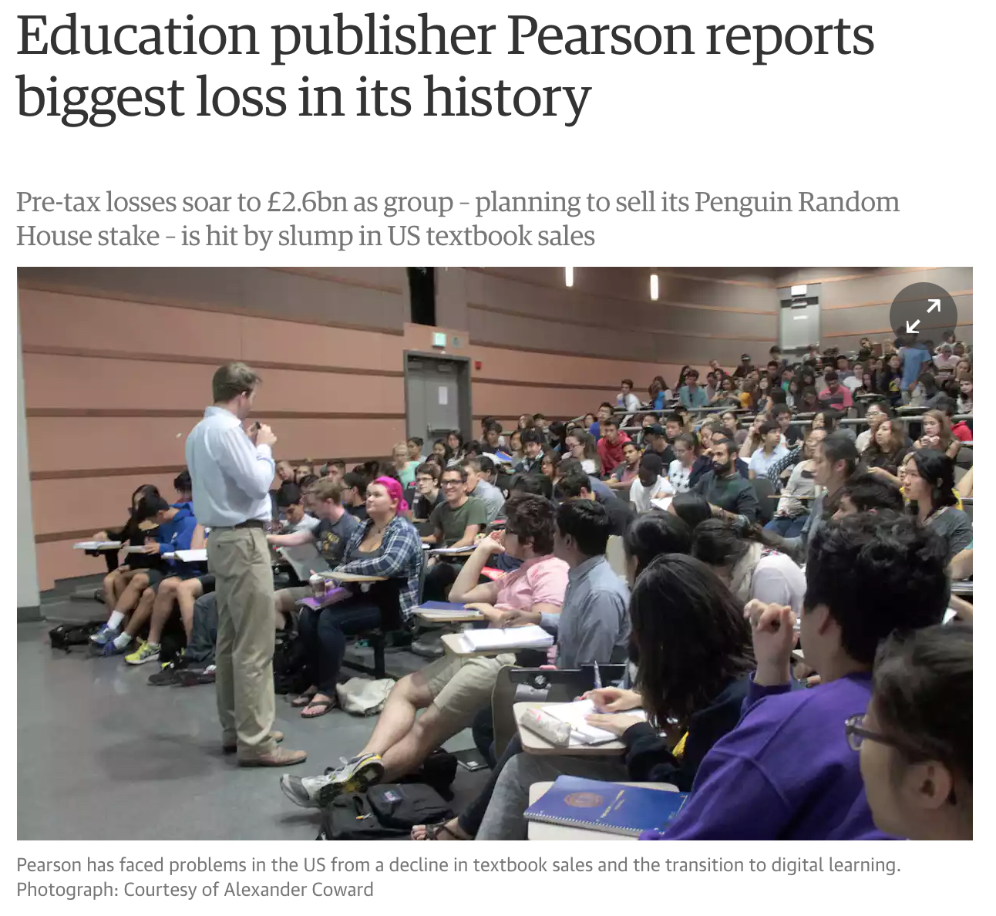
Publishers - Pearson

Slide 33
Publishers - Nelson
In Canada, each province and territory has authority over curriculum development and education funding for the K-12 Market. Following a historic high in Canada in 2006 with respect to new curriculum development and spending, the K-12 Market contracted. The K-12 Market has been negatively affected by reduced spending on new curriculum by Canadian schools over the last five years, and in particular the spending decline in Ontario which represents the largest proportion of educational spending in Canada.

Slide 34
Publishers - Nelson
The Higher Education Market has been negatively affected by, among other things: a lack of clarity at universities with respect to ‘ancillary fees’; with certain institutions banning digital homework solutions with added fees; increased traction in the open textbook movement due in part to government funding in a number of provinces; and the use of used books, rental books and peer-to-peer sharing, impacting the demand for new textbooks at universities and colleges in Canada. The impact caused by used books and rental books is mitigated by revisions cycles and new textbook editions, the adoption of digital materials and increased use of custom and indigenous products. In addition, the Higher Education Market is in transition from traditional books to digital products, which is having a transformative effect on the business.

Slide 35
Publishers – BC Study
Scholarly and educational publishers share some of the same issues as trade publishers, but they face other unique challenges. Tablet and other nonprint use will increase in the school systems here and abroad, changing how educational materials are bought, used and updated. Scholarly publishers and trade publishers that sell into the academic market are struggling with the impact on their sales of Open Access and fair use policies, tailored subscription services such as Scribd’s Edelweiss, used book sales, student piracy and increased library use for class reading lists.

Slide 36
What Next?

Slide 37
Fight for Fairness

Slide 38
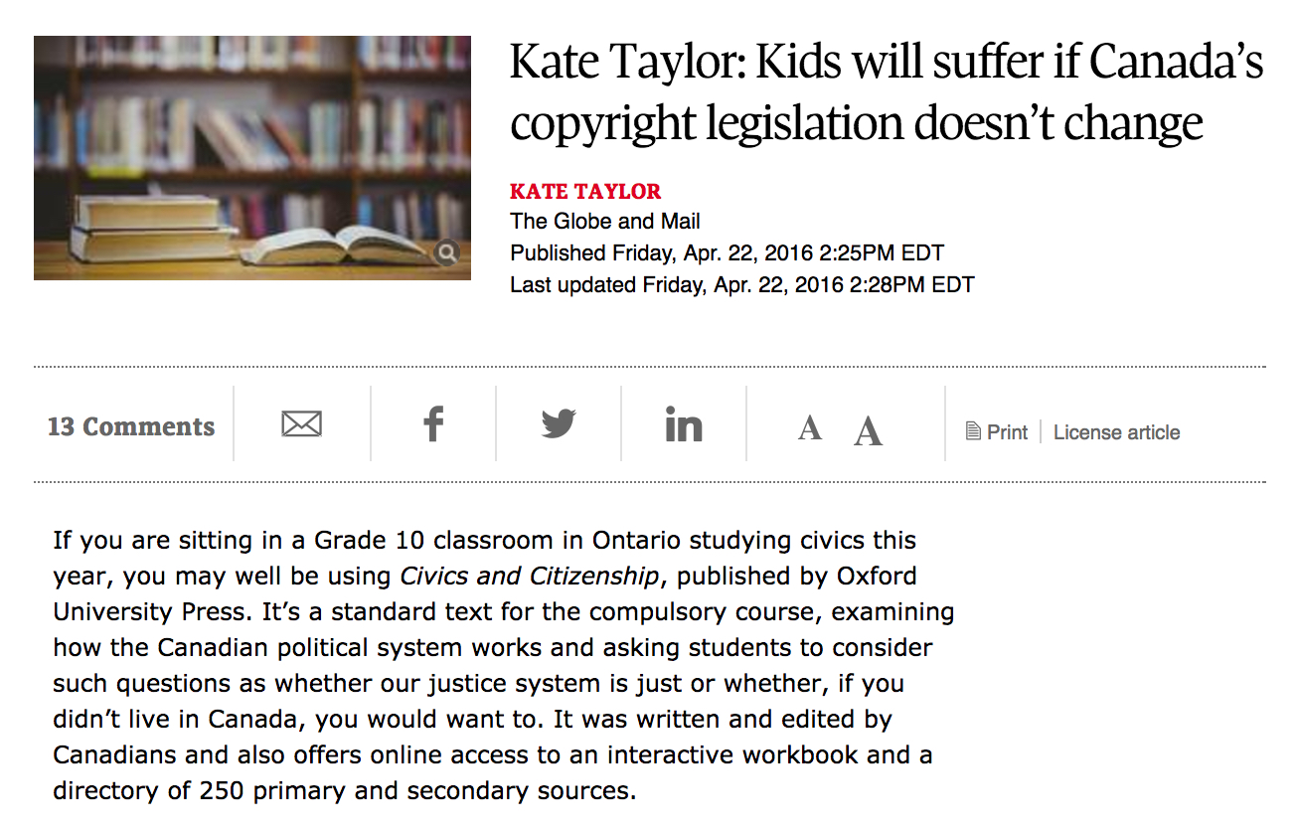

Slide 39
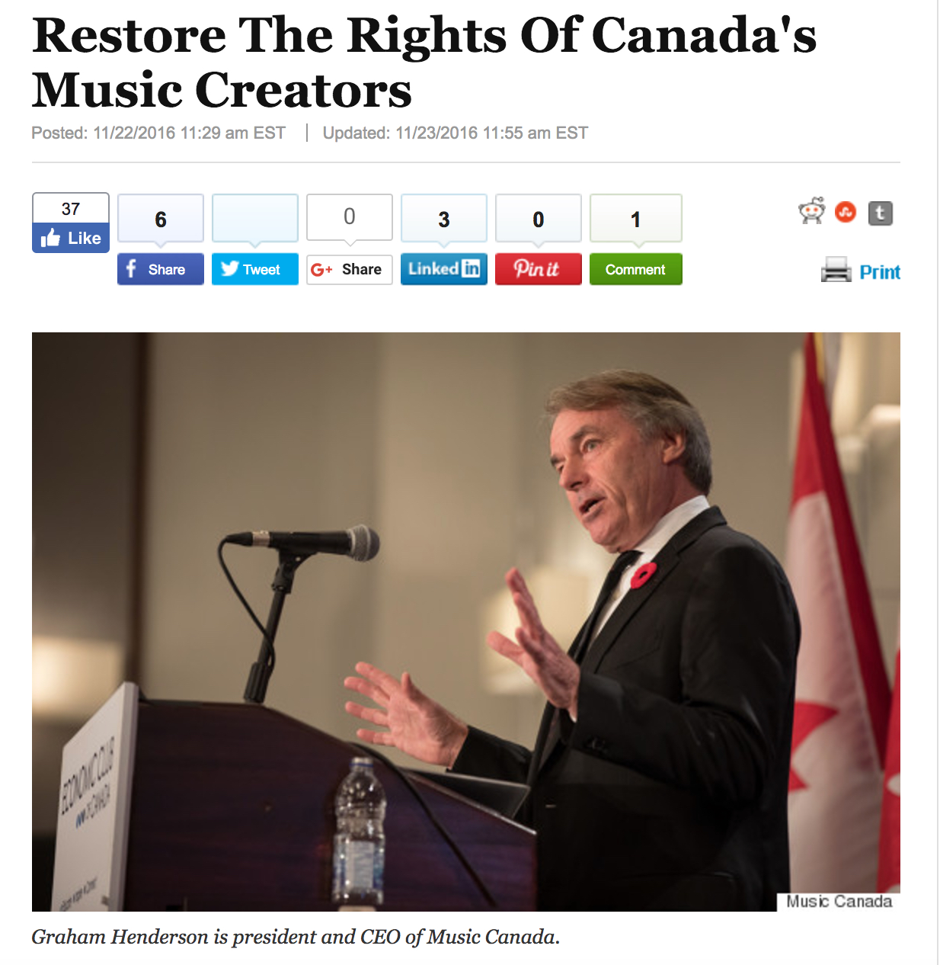

Slide 40
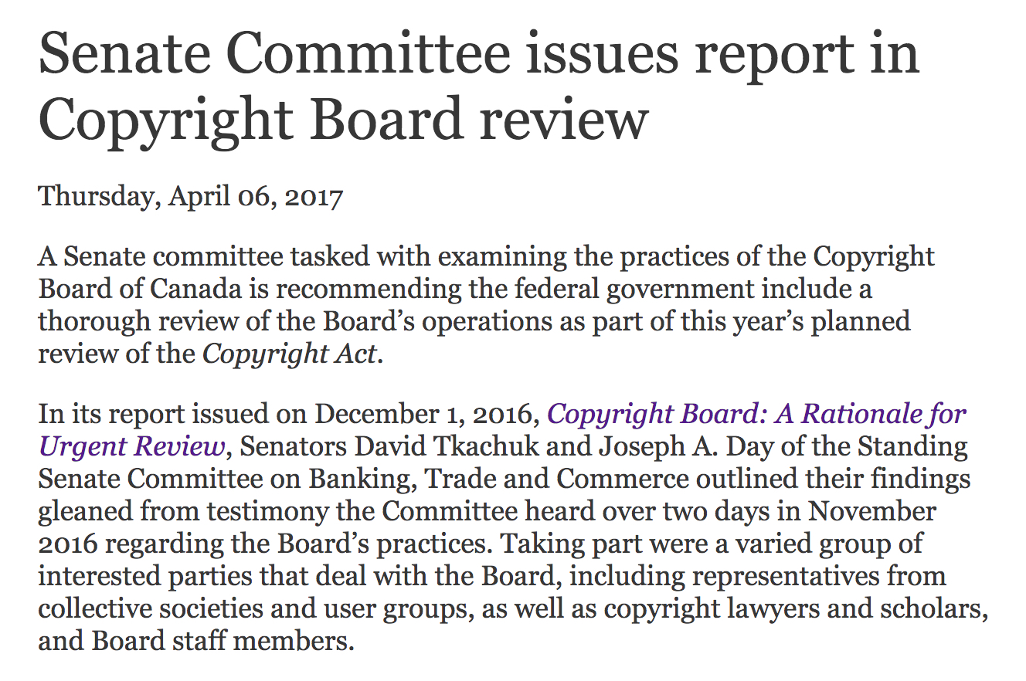

Slide 42
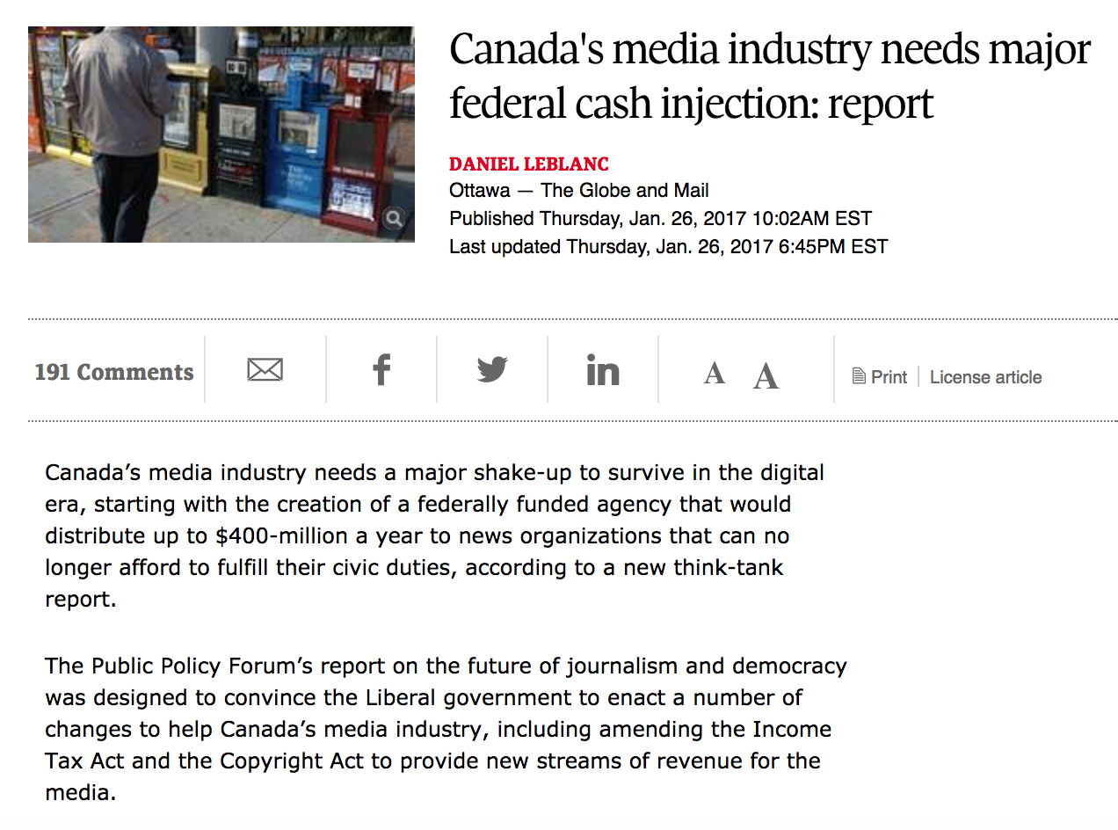

Slide 43
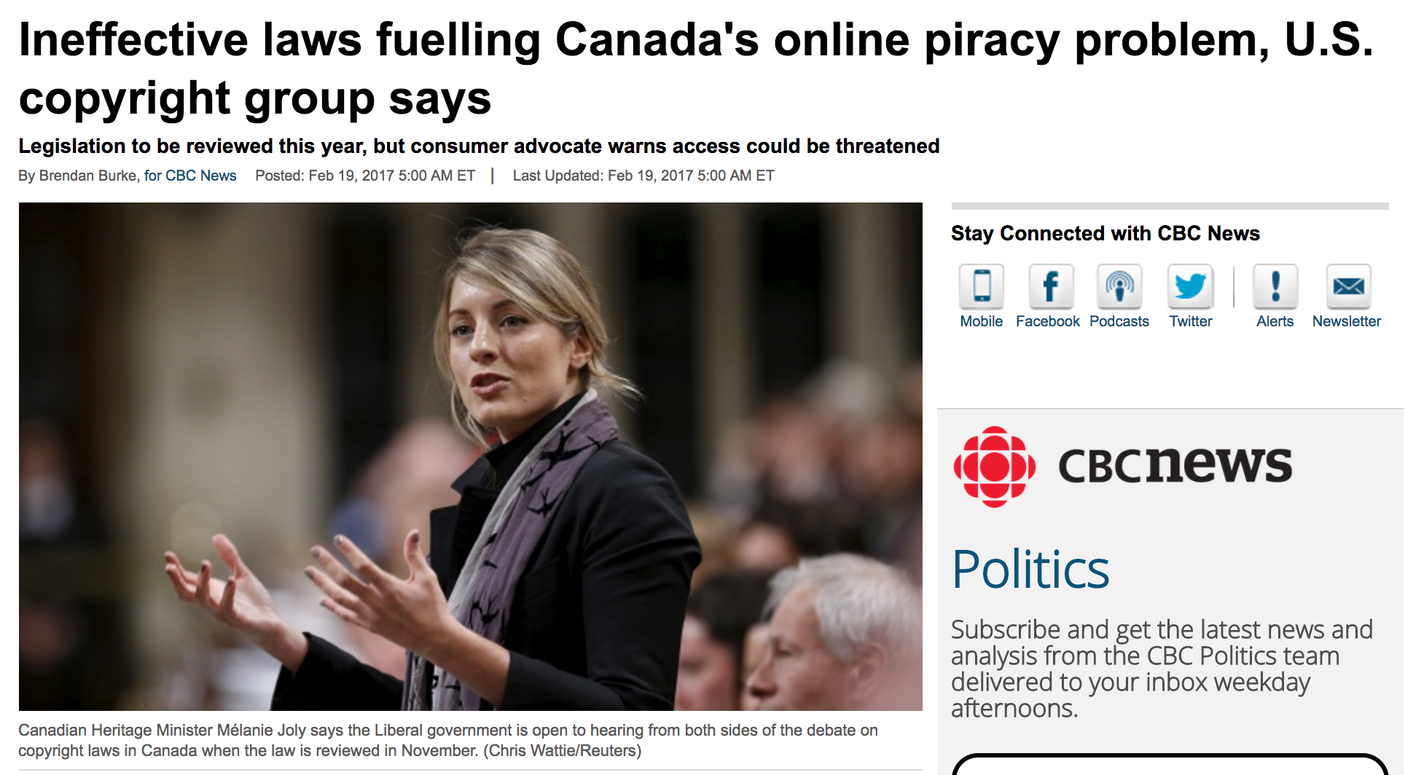

Slide 44
Defensive

Slide 45
Positive Agenda

Slide 46
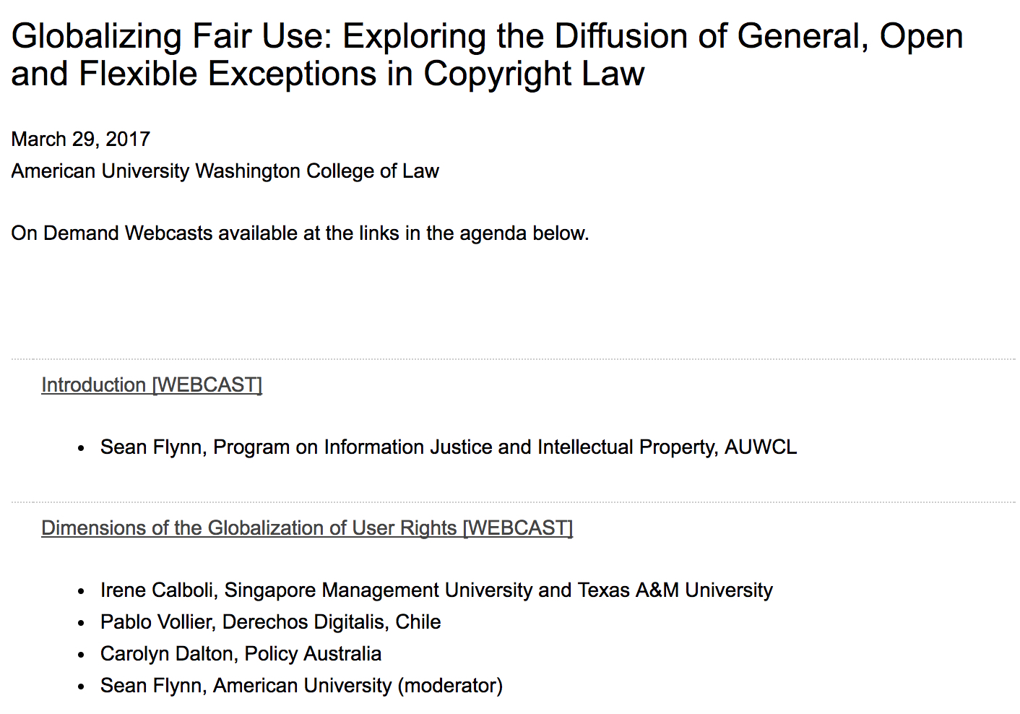

Slide 48
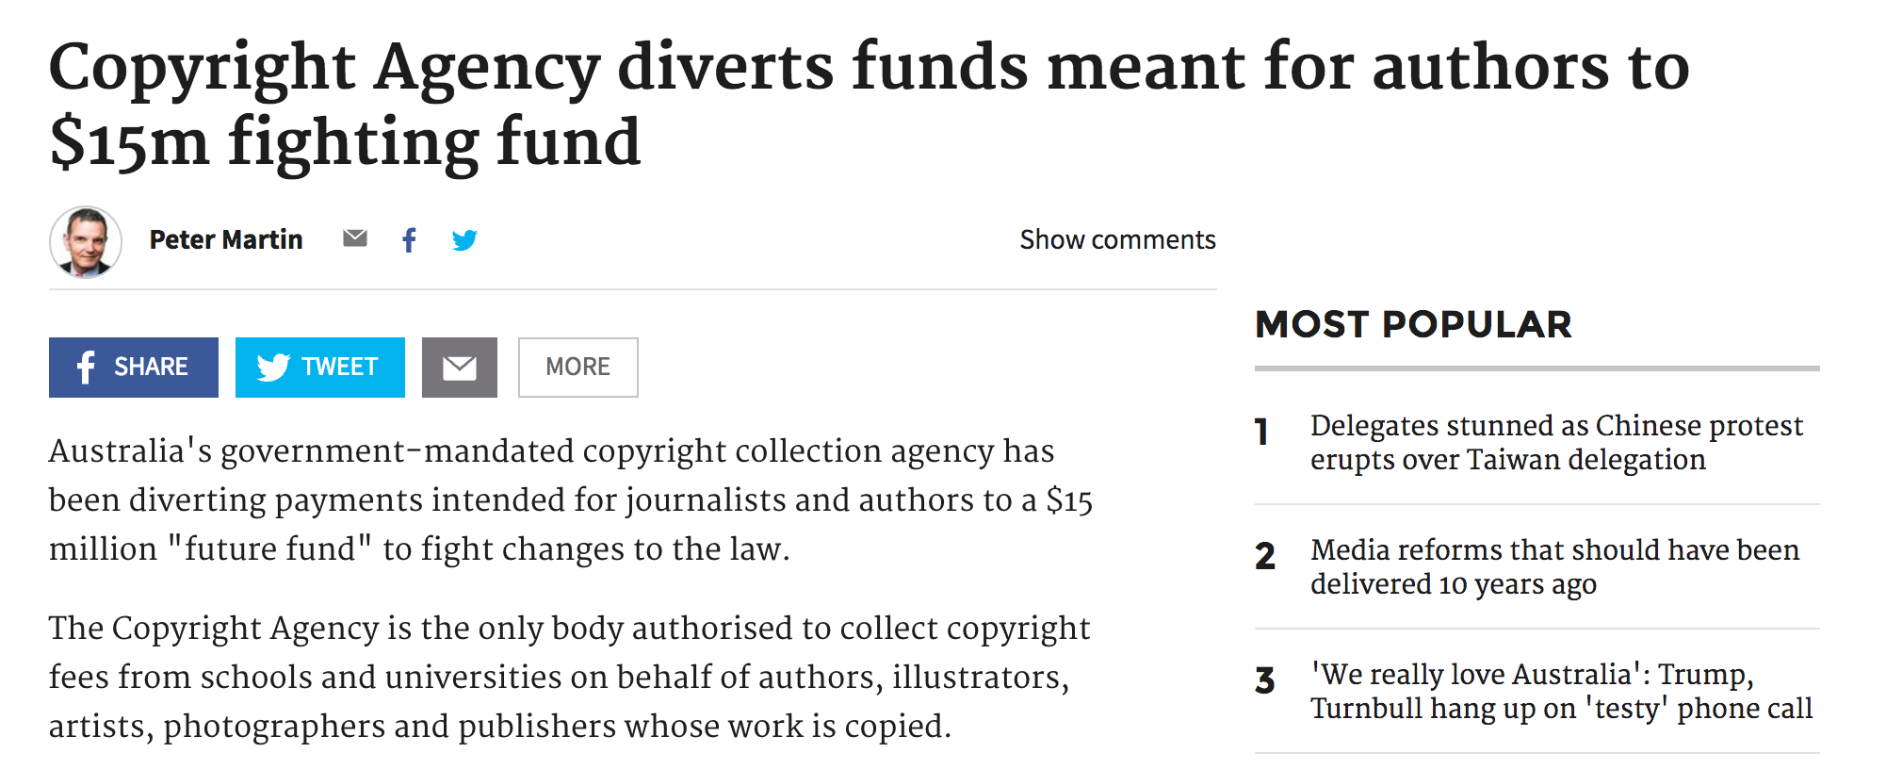

Slide 49
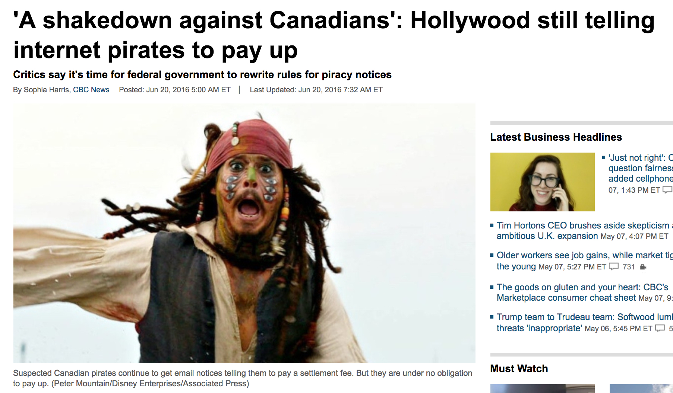

Slide 50
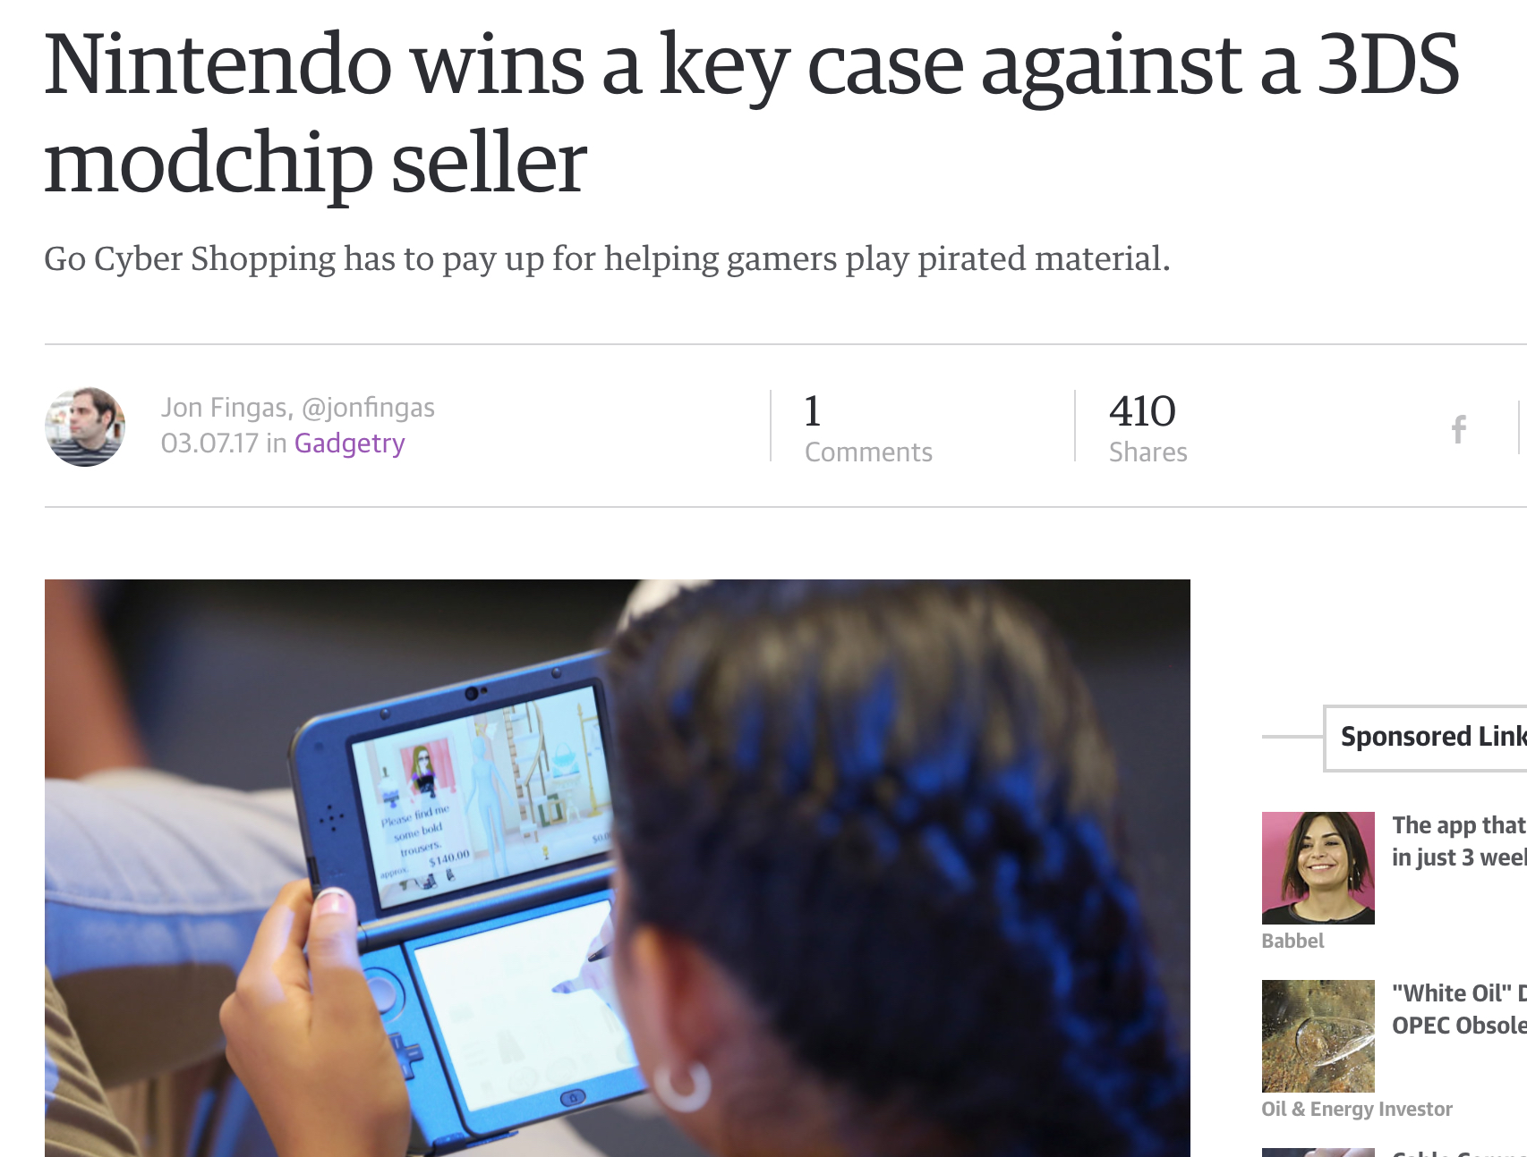

Slide 51
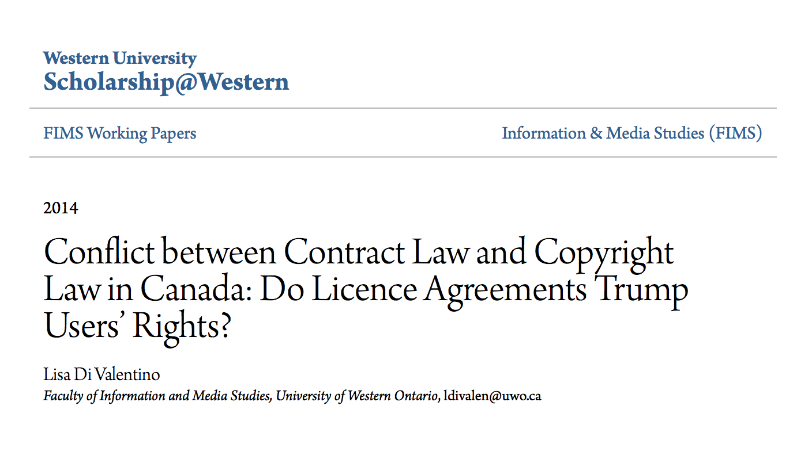

Slide 52
Ideas

Slide 53
Ideas Evidence

Slide 54
Ideas Evidence Voice

Slide 55
@mgeist

